Slide 1

CPE 490 Embedded Systems
C relational and Logical Operators (14.2.7)
Looping with While command (14.2.8)
Preprocessor Directives (14.2.9)
dsPIC33 Timer 1 (data sheet section 12)

Slide 2
Operators in C
There are 47 operators that can be used in C
Operators are used to make complex expressions
In general operators operate on variables and the number of operands can classify some of the operators
Unary
Binary
Ternary
Notes:
Unary is pronounced Yoo-nuh-ree

Slide 3
Operators in C
Order of Precedent must be known to evaluate correctly
All are evaluated left to right except unary operators
Example X/Y will mean X divided by Y
Unary operator is evaluated from right to left
Example !X the logical value or X is inverted
See table A6.5 in appendix 6 of your text

Slide 4
C Logical Operators
In C there is no distinction between arithmetic expressions and logical ones
FALSE is represented by the integer 0
TRUE is represented by any integer not 0 but if the result of a logical operation will be 1
|| The logical OR operator
&& The logical AND operator
! The logical not operator
Notes:
There are bit wise logical operators that we will cover at a later time.
These are mostly binary operators, but the not operator is an example of a unary.

Slide 5
Simple order of Precedence Chart
Operator Precedence Chart
Operator Type | Operator | Associativity
Primary Expression Operators | () [] . -> expr++ expr-- | left-to-right
Unary Operators | * & + - ! ~ ++expr --expr (typecast) sizeof | right-to-left
Binary Operators | * / % | left-to-right
 | + -
 | >> <<
 | < > <= >=
 | == !=
 | &
 | ^
 | |
 | &&
 | ||
Ternary Operator | ?: | right-to-left
Assignment Operators | = += -= *= /= %= >>= <<= &= ^= |= | right-to-left
Comma | , | left-to-right
Notes:
See web link on BlackBoard

Slide 6
Parenthesis Operator ()
Has the highest precedence
Can be nested and used to make order of operation clearer
Example
x = y/3-34*temp&&127
x =((y/3) – (34*Temp)) && 127;
Notes:
This example shows explicitly what the precedence of operations will do.

Slide 7
Logical Operator Examples
a = 17;
b = 1;
c =(a||b); c is 1
c = (a && b); c is 1
c=(!a); c is 0

Slide 8
C Relational Operators
OPERATOR | ACTION
> | Greater than
>= | Greater than or equal to
< | Less than
<= | Less than or equal to
== | Equal to
!= | Not Equal to

Slide 9
Relational Operator Examples
a = 10;
c = (a >1); // c is 1
c = (-a >= 0); // c is 0
c = (a == 17); // c is 0
c = (a != 3); // c is 1
Notes:
Parenthesis are not needed because assignment is low priority.
In the third line the unary – operator as high precedence so that a is made negative first.

Slide 10
Order of Precedents
HIGHEST
!
> >= < <=
== !=
&&
||
Lowest

Slide 11
Examples
c = (a ||b) && !( a && b);
x=10;
y=9;
c = x >= 8 && y<= x;
c = 8 && 0;
Notes:
First is an XOR function
Second – looking at the order of operations (x >= 8) && (y <= x) the answer is c = 1
Third c = 0

Slide 12
Preprocessor Directives
Like Assembler directives, these statements can give direction to the compiler before it starts the compilation process.
Two we will used often are
#include
#define
A list of preprocessor directives are given in the text in Appendix 6 in Table A6.6

Slide 13
# define
All statements beginning with # are preprocessor directive that are instructions to the C compiler.
Form: #define identifier string
Statement defines an identifier and a string that will be substituted for the identifier
Notice that the statement does not end with a semicolon.

Slide 14
# define examples
#define TRUE 1
#define FALSE 0
#define MaxSize 16
Notes:
The words TRUE and FALSE are easier to read in code then remembering the logical meaning of 1 and 0.
The define can be used, to define say a stack size. If you wanted all code that was used to check to see if the stack was going overflow could use ‘MaxSize’ and then if the stack size ever changed than all you would have to do is change the define statement in one place.

Slide 15
while Keyword
In c the while keyword will cause a statement or a group of statements to execute repeatedly as long as a condition is true.
The general while structure is:
while (conditional expression) statement;
The condition can be a logical or relational statement.
A single statement can be replaced by a block of statements located inside curly brackets {}

Slide 16
while loop example
# define TRUE 1
main ()
{
// initialization code
while (TRUE)
{
// code that will be repeated while the processor has power
}
}
Notes:
Notice that the while loop will run forever the condition is always true.
If the processor resets than you must wait for reboot, and then the c0 code and then the initialization code will run, in contrast if you use an endless while loop so that you never have to execute a reset and this overhead code will not be rerun.

Slide 17
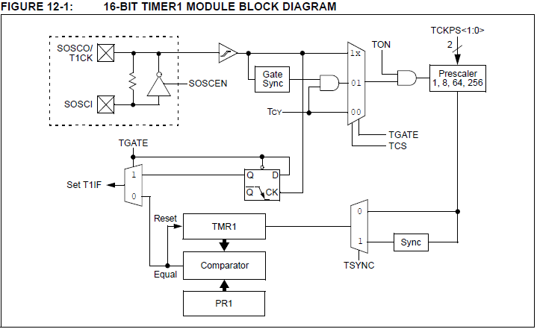
dsPIC33 Timer 1
Notes:
TON is a universal on/off switch for the timer.
Four modes of operation 1) Timer mode (we will use this one TGATE = 0, TCS = 0 and TSYNC is don’t care) interrupt given when TMR1 = PR1
2) Gated timer mode (TGATE =1, TCS = 0 and TSYNC is a don’t care) in this mode an interrupt is given every time there is a falling edge on T1CK. This mode will time how long the external signal stays true.
3) Synch external clock mode (TGATE is a don’t care, TCS = 1, and TSYNC =1) interrupt on TMR1 = PR1
4) Asynch external clock mode (TGATE is a don’t care, TCS = 1, and TSYNC =0) interrupt on TMR1 = PR1
The timer can be driven by one of two sources the main clock time period (main clock period divided by two also called Tcy) or it can have an external watch type crystal 32.768 Khz as a source, or it can be a counter looking at the rising edge of T1CK. Finally if the internal main clock is the source it can be gated with a logic signal coming into T1CK. The register to make these selection is T1CON
The prescaler can be set to one of 4 values. The prescalar has the effect of multiplying the clock period by the number it is set to. Think of it as an accumulator that must see the programmed number of cycles before putting out one cycle
The comparator can be used to generated an interrupt when ever the TMR1 matches PR1. Note PR1 is FFFF upon reset.

Slide 18
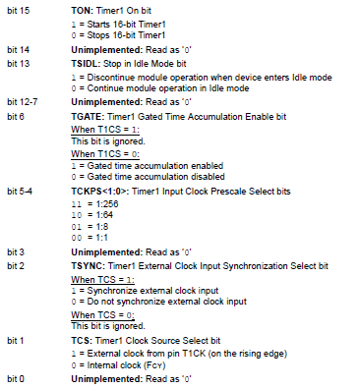
The T1CON Register

Slide 19
Timer Setup Example
Given that you would like Timer 1 to be enabled, driven off of the main clock oscillator, with no gate synchronization, and prescaler of 64, and we want to continue to function in idle mode.
The T1CON register should be
T1CON = 0b1000 0000 0010 0000;
T1CON = 0x8020;

Slide 20
Timer Setup Example
Given the last setup, and that the external oscillator is 32 MHz and that the PLL is not used what is the period of one count of the TMR1 counter
T = 2/32 MHz * 64 = 4 uSeconds
Notes:
The PLL is used to increase the main oscillator frequency used by the dsPic33 we will talk about it later.

Slide 21
Easy Delay in C
#define Delay4ms 1000
TMR1 = 0;
while (TMR1< Delay4ms)
{
//just wait
}
Notes:
Knowing the time period for one count you can get multiples of this delay by specifying Delay. So using our last example if Delay = 1000, than the delay period would be 4 uS X 1000 = 4 mSeconds
What is the longest delay we can make with a 32 MHz oscillator? 1/32E6 X 2 * 256 * 2^16 = 1.0486 seconds Note must make sure PR1 is set to 0xFFFF so as not to reset the timer early.

Slide 22
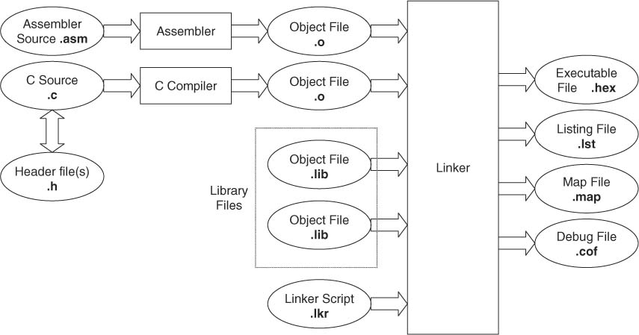
Example C File Structure
Header and library files are extensively used, with the result that hardly any C source files are stand-alone. Once the ‘extra’ files are incorporated, the final executable program is built up from a number of contributing files, often in quite a complex way. In turn, the process of compiling a C program creates a range of output files. The process of compiling is illustrated below.
Notes:
Notice how assembly code can be linked into the program

Slide 23
Why Assembler Code in C
You need exact timing in a function
You need control over memory in a way that is not being done with the C compiler.
XC16 C compiler (see chapter 13 in Compiler user guide) supports:
Using C variables and functions in assembler code
Using assembler variables and functions in C code
Drawback – code is no longer portable

Slide 24
In line Assembler Code
The C30 compiler will allow using inline assembly language
An example:
asm("nop");
Will cause a nop assembly language instruction to be place in the C-Code.

